Slide 1
Contemporary Moral Problems
M-F12:00-1:00SAV 264
Instructor: Benjamin Hole
Office Hours: everyday after class
Email: bvhole@uw.edu

Slide 2
Agenda
Where we are / review upcoming writing assignment
Transition from Bentham to Mill
Quantitative to qualitative hedonism
Act to rule utilitarianism
Rejection of moralism / harmless wrongdoing
Begin discussion of Mill’s Harm Principle

Slide 3
Week | Required Reading | Assignment
Course Mechanics, Theory Primer, and Philosophical Argumentation 6/23-6/27 | Benjamin Hole, Phil 102 Syllabus Lewis Vaughn (posted on website), “How to Read an Argument” Mark Timmons, “Moral Theory Primer” | WA1, due 6/27
Philosophical Writing and Ethical Theory 6/30-7/3 (Holiday, 7/4) | Mark B. Woodhouse (posted on website), “How to Write Philosophy” James Rachels (posted on website), “The Challenge of Cultural Relativism” Jeremy Bentham (posted on website), “The Principle of Utility” Robert Nozick, “The Experience Machine” (posted on website) | None
Ethical Theory 7/7-7/11 | J.S. Mill (electronic), On Liberty, Chapters 1-2 Immanuel Kant (posted on website), “The Moral Law” | WA2, due 7/8
Introduction to Sexual Ethics 7/14-7/18 | The Catholic Church, “Vatican Declaration on Some Questions in Sexual Ethics” John Corvino, “A Defense of Homosexuality” Thomas Mappes, “A Liberal View of Sexual Morality and the concept of Using Another Person” | None
Introduction to International Ethics 7/21-7/25 | Peter Singer, “Famine, Affluence, and Morality” (posted on website) Garrett Hardin, “Lifeboat Ethics” (posted on website) | WA3, due 7/22
Introduction to Social and Political Ethics: Censorship and Pornography 7/28-8/1 | Ronald Dworkin, “Liberty and Pornography” Judith M. Hill, “Pornography and Degradation” Catharine MacKinnon (posted on website), “Pornography, Civil Rights, and Speech” | None
Abortion 8/4-8/8 | Pope John Paul II, “The Unspeakable Crime of Abortion” Mary Anne Warren, “On the Moral and Legal Status of Abortion” Don Marquis, “Why Abortion Is Immoral” | WA4, due 8/5
Conference for Final Papers 8/11-8/15 | Catch-up if we’ve fallen behind. Conference for Final Papers: presentations and discussion | None
Abortion 8/18-8/22 | Judith Jarvis Thomson, “A Defense of Abortion” Rosalind Hursthouse, “Virtue Ethics and Abortion” | WA5, due 8/19 Final Paper, due 8/21

Slide 4

Please set your Turning Technology Clicker to channel 41
Press “Ch”, then “41”, then “Ch”

Slide 5
Bentham claims that nature has placed mankind under two sovereign masters:
pain and pleasure.
good and evil.
God and the devil.
duty and self-interest.
all the above.
none of the above.

Slide 6
Which of the following is not one of Nozick's reasons for not plugging in to the experience machine?
We want to do certain things with our lives.
We want to be a certain kind of person.
There is no contact with reality inside the machine.
We cannot benefit the mental states of others once we are inside the machine.
None of the above

Slide 7
John Stuart Mill claims that the subject of his essay, On liberty, is:
Liberty of the Will: how “free will” is metaphysically possible
Quantitative hedonism
Deontology
Civil, or Social Liberty: the nature and limits of the power which can be legitimately exercised by society over the individual
Act utilitarianism
None of the above

Slide 8
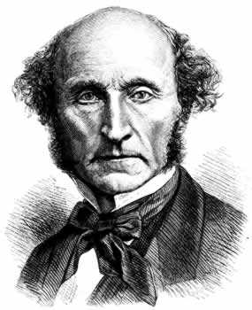
John Stuart Mill
(1806-1873)
Transition from Bentham’s Utilitarianism to Mill’s On Liberty

Slide 9
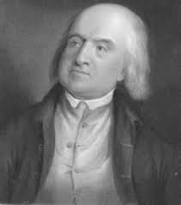
Bentham’s Hedonistic Utilitarianism
Review
Theory of the Right
Theory of the Good
Review what each of these are for Bentham and some of the biggest objections to each.

Slide 10
John Stuart Mill
(1806-1873)
Greatest happiness principle
“Actions are right in proportion as they tend to promote happiness; wrong as they tend to produce the reverse of happiness.”

Slide 11
John Stuart Mill
(1806-1873)
Child of James Mill, who was a close friend of Bentham
Raised as a living exhibit of the power of utilitarianism
A celebrity as a child, touring Europe to defend utilitarianism
Read Greek at three …

Slide 12
Mill has a mental breakdown at age 20
“[I] had what might truly be called an object in life; to be a reformer of the world. My conception of my own happiness was entirely identified with this object. . . [I]t occurred to me to put the question directly to myself:
"Suppose that all your objects in life were realized; that all the changes in institutions and opinions which you are looking forward to, could be completely effected at this very instant: would this be a great joy and happiness to you?"
And an irrepressible self-consciousness distinctly answered, "No!"
At this my heart sank within me: the whole foundation on which my life was constructed fell down.
(From Mill’s Autobiography: http://www.utilitarianism.com/millauto/five.html)

Slide 13
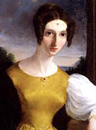
At age twenty-five
Mill meets Harriet Taylor, who is already married to John Taylor
They write together in a chaste relationship for twenty-one years
They are married in 1851, two years after the death of John Taylor

Slide 14
Relevance?
Themes:
Experiments in living
Truths not easily captured by single systems
Feminism
Aspects of human well-being not captured by pleasure or pain

Slide 15
Relevance?
What this will lead to:
A revised version of utilitarianism, in which we judge actions and social policy with reference to the “permanent interests of man as a progressive being.”
It will avoid some of the more implausible bits of Bentham

Slide 16
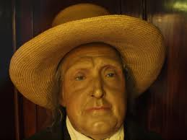
The Big Problems Bentham’s Utilitarianism
Distribution Objection
Aggregation objection, scapegoat objection, justice objection, rights objection, fairness objection.
Demandingness Objection
Hedonism Objections
Notes:
16

Slide 17
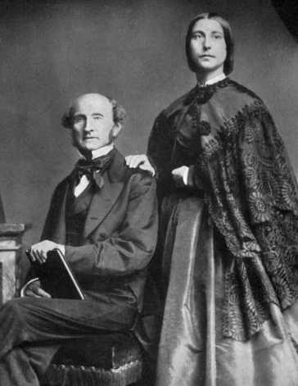
MILL’S ON LIBERTY
Rejects Bentham’s Quantitative Hedonistic Utilitarianism
Responds to (a) Distribution and (b) Demandingess Objections
Proposes the Harm Principle
Champions “experiments in living”

Slide 18
Mill revises Bentham’s Hedonism
Objection
Response
Hedonism is a “doctrine worthy of a swine”
The objection depends on an improvised idea of pleasure
Rather there are higher and lower pleasures

Slide 19
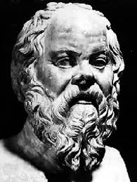

Mill revises Bentham’s Hedonism
“"it is better to be a human being dissatisfied than a pig satisfied; better to be Socrates dissatisfied than a fool satisfied“”

Slide 20
“"it is better to be a human being dissatisfied than a pig satisfied; better to be Socrates dissatisfied than a fool satisfied“”
Strongly Agree
Agree
Somewhat Agree
Neutral
Somewhat Disagree
Disagree
Strongly Disagree

Slide 21
Mill responds …
Objection
Response
Demandingness
“there is not time, previous to action, for calculating and weighing the effects”
“The answer to the objection is that there has been ample time, namely the whole past duration of the human species”

Slide 22
Mill’s utilitarianism
Rules of Thumb
On the basis of human experience, we can derive rules of thumb about which kinds actions produce the best consequences.
The Harm Principle
In the absence of some direct harm to a non-consenting other person, there is no justification for coercion designed to prevent an action.

Slide 23
The Collapse of RC Argument
Does RC admit exception cases?
If no
If yes
Distribution objection
Rule Worship

Slide 24
The Collapse of Rule Consequentialism
“Either rule-consequentialism collapses into practical equivalence with the simpler act-consequentialism, or rule-consequentialism is incoherent.” (http://plato.stanford.edu/entries/consequentialism-rule/)
If RC collapses, it is not a viable ethical theory.
It is not a different theory than act consequentialism (and therefore also vulnerable to the same objections).
If RC is incoherent, it is not a viable ethical theory.
It depends on a theory of The Right; it takes a system or rules as primary and not value (pleasure).
Therefore, RC is not a viable ethical theory.

Slide 25
Is RC a viable ethical theory?
Yes
No

Slide 26
Context for social & Political Ethics
Background Terminology

Slide 27
General approaches to social & Political Ethics
Moralism
Conservatism
Liberalism
Masturbation
Sodomy & Oral Sex
Premarital sex
Homosexuality
Adultery
Deception, coercion, exploitation (Mappes)
Biomedical
Social-Political
Pornography and Censorship

Slide 28
Moralism
Moralism argues that some things may be wrong even if there is no non-consenting person that is harmed.
Also called: harmless wrongdoing, e.g.
Some forms of pornography
Some forms of bestiality
Some forms of incest
Some forms of consensual cannibalism
Notes:
These are disgusting - that’s the point. Now: it’s time to talk about sex, since that’s where many of us start to feel these emotions.

Slide 29
Conservativism
Conservatism isn’t one sort of argument, but many; what links them is some space for moralism as a ground for prohibition
Edmund Burke grounds conservative thought in the limited power of human reason, in face of the wisdom of tradition
Lord Patrick Devlin, grounds it in the need for social unity
The Catholic Church grounds it in the natural purposes found in God’s creation

Slide 30
Liberalism
Like conservatism, liberalism is a family of theories.
Rejection of moralism.
“Mill … argued that ‘the burden of proof is supposed to be with those who are against liberty; who contend for any restriction or prohibition…. [the] assumption is in favour of freedom…’” <http://plato.stanford.edu/entries/liberalism/>

Slide 31
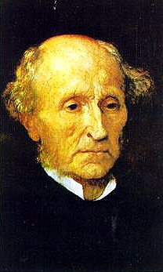
The Rejection of Moralism
"If all mankind minus one were of one opinion, and only one person were of the contrary opinion, mankind would be no more justified in silencing that one person than he, if he had the power, would be justified in silencing mankind."

Slide 32
THE HARM PRINCIPLE
"If all mankind minus one were of one opinion, and only one person were of the contrary opinion, mankind would be no more justified in silencing that one person than he, if he had the power, would be justified in silencing mankind."

Slide 33
THE HARM PRINCIPLE
In the absence of some direct harm to a non-consenting other person, there is no justification for coercion designed to prevent an action.
This is a radical principle, since it would allow many things we don’t.

Slide 34
The Harm Principle
Strongly Agree
Agree
Somewhat Agree
Neutral
Somewhat Disagree
Disagree
Strongly Disagree

